Slide 1

Analysis of Advertisement Data of Automotive Brands
Presented By:- Maninder Singh

Slide 2
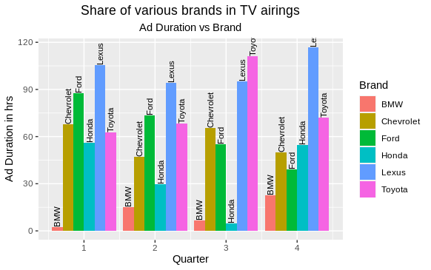
Quarterly Ad Duration of Brands
1. What is the share of various brands in TV airings and how has it changed from Q1 to Q4 in 2021?
Graph 1.0 represents the duration in hours of Advertisement played by each Brand Quarter-wise
Lexus has the highest share in Ad Duration in all Quarters with a total of 411 hours of runtime.

Slide 3
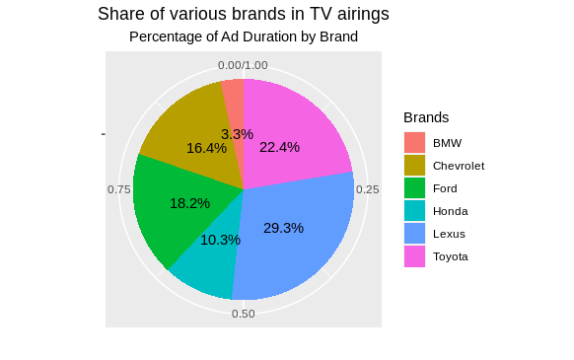
Percent Quarterly Ad Duration of Brands
Graph 1.2 represents the Percentage duration in hours of Advertisement played by each Brand through the year.
Lexus (29.3%)
Toyota (22.4%)
Ford (18.2%)
Chevrolet (16.4%)
Honda (10.3%)
BMW (3.3%)

Slide 4
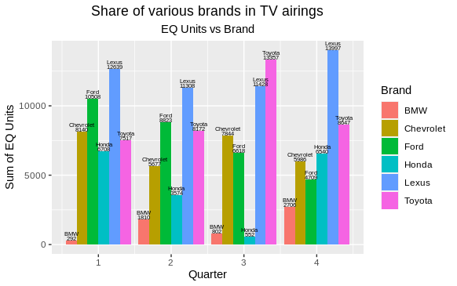
Quarterly EQ Units Brands-wise
Graph 1.3 represents the EQ Units w.r.t each Brand Quarter-wise.
Lexus has the highest share in EQ Units in all Quarters with a total of 49372 EQ Units.

Slide 5
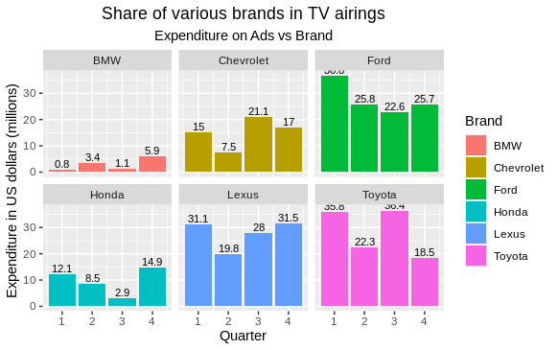
Quarterly Expenditure of Brands
2. Conduct a competitive analysis for the brands and define advertisement strategy of different brands and how it differs across the brands.
Toyota has the largest Advertisement Expenditure with 112.9 Million USD which is ¼ of the gross expenditure of all the brands.
Ford is the second largest firm with total 110.9 Million USD of ad expenses, following by Lexus with 110.34 Million USD.
These 3 brands make up to 75% of Total Ad-spendings.

Slide 6
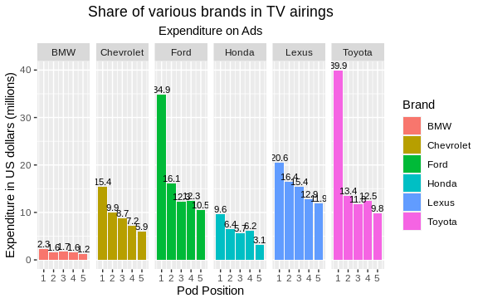
Expenditure of Brands on various Pod positions
Graph 1.5 represents the expenditure of all the Brands on Pod positions(1-5).
Toyota has spent the highest on Pod position 1, following by Ford and Lexus.

Slide 7
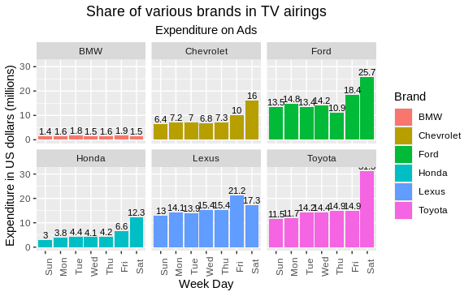
Expenditure of Brands throughout the Week
The Graph 1.6 represents the expenditure of all the Brands on different days of a week.
It is a general trend that the spendings on advertisements increases as the weekends draws close and the highest amount is spent on Sundays.

Slide 8
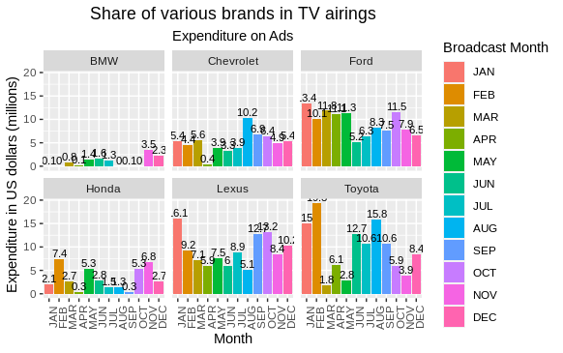
Expenditure of Brands throughout the Year
The monthly expenses of all the Brands throughout the year is represented by graph 1.7
Ford ,Lexus and Toyota has similar nature of spendings as the companies have the highest amount spent in Jan and Feb.

Slide 9
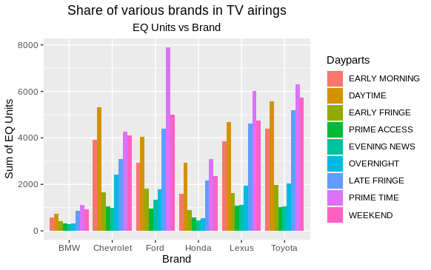
EQ units of Brands
3. Toyota wants to run a digital ad campaign to compliment its existing TV ads in Q1 of 2022. Based on the data from 2021, suggest a media plan to the CMO of Toyota.
As represented by graph 1.8 , majority of the advertisements were targeting the Prime Time and Weekend.
The data can be seen to make a parabola and the EQ units are minimum in Prime Access and Evening News
Toyota should run ads in Prime Time and Weekends and decrease running ads in the Prime Access and Evening News.

Slide 10
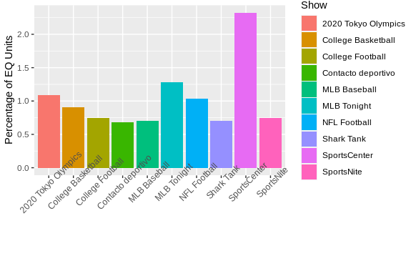
Which audience should they target?
As represented by graph 1.9, Sports Shows such as SportsCentre and MLB Tonight has the highest share of EQ Units. The difference between EQ Units of 1st and the 2nd show is 81%.
Adults between the ages of 35 and 44 were the most likely to watch these shows.

Slide 11
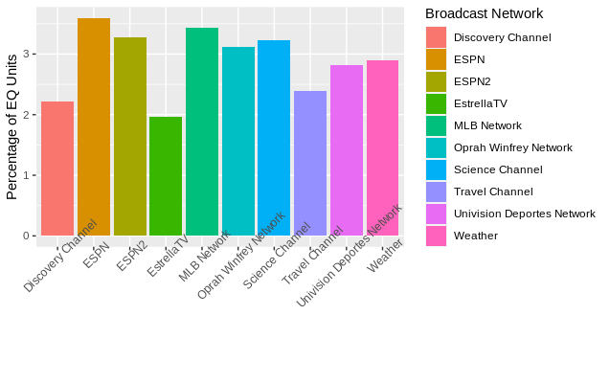
Which audience should they target? contd.....
The total share EQ Units is 11% for broadcast and 89 % for cable and it is evident from the previous slide that Sports Shows have higher EQ Units.
Therefore, we should focus our advertisements on Networks such as ESPN and ESPN2 where the Network Type is Cable.

